Slide 1
Announcements
Project 3: MDPs and Reinforcement Learning
Due Friday 3/7 at 5pm
Optional contest
Due Thursday 3/13 at 11:59pm
Midterm 1
Monday 3/10, 6:30pm-9:30pm
[A-F] 120 Latimer
[G-S] 1 Pimentel
[T-Z] 145 Dwinelle
Preparation page up
Topics: Lectures 1 through 11 (inclusive)
Past exams
Special midterm 1 office hours
Practice Midterm 1
Optional
One point of EC on Midterm 1 for completing
Due: Saturday 3/8 at 11:59pm

Slide 2
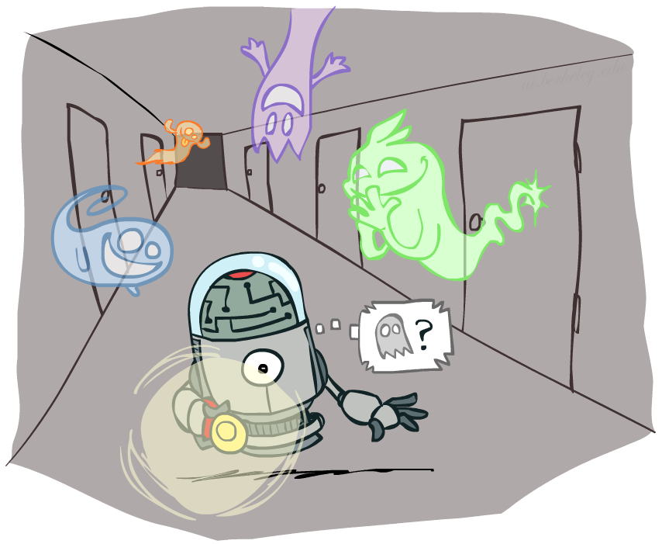
CS 188: Artificial Intelligence
Hidden Markov Models
Instructors: Dan Klein and Pieter Abbeel --- University of California, Berkeley
[These slides were created by Dan Klein and Pieter Abbeel for CS188 Intro to AI at UC Berkeley. All CS188 materials are available at http://ai.berkeley.edu.]
Notes:
Please retain proper attribution, including the reference to ai.berkeley.edu. Thanks!

Slide 3
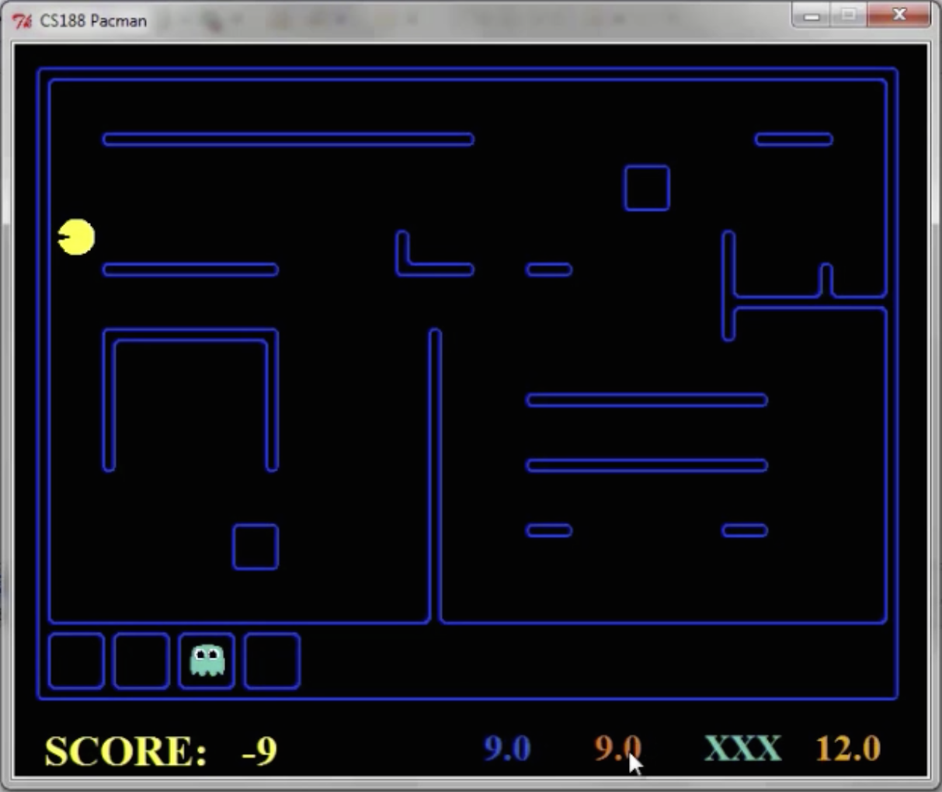
Pacman – Sonar (P4)
[Demo: Pacman – Sonar – No Beliefs(L14D1)]

Slide 4

Video of Demo Pacman – Sonar (no beliefs)

Slide 5
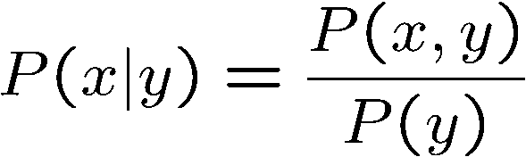
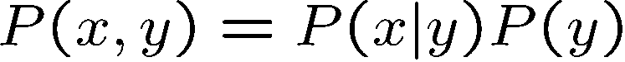
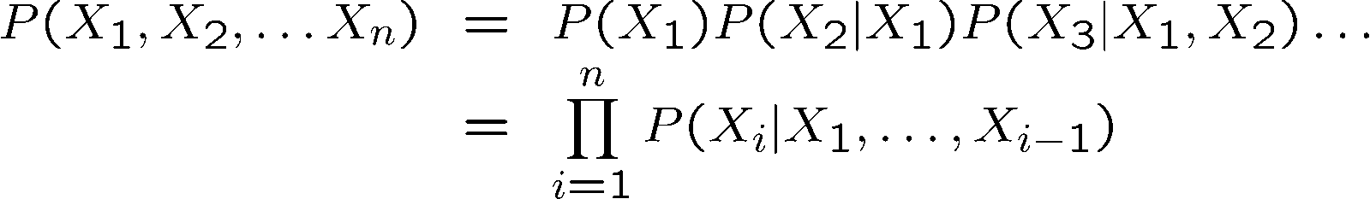
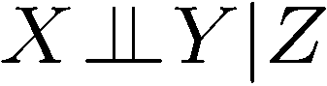
Probability Recap
Conditional probability
Product rule
Chain rule
X, Y independent if and only if:
X and Y are conditionally independent given Z if and only if:

Slide 6

Hidden Markov Models

Slide 7
Hidden Markov Models
Markov chains not so useful for most agents
Need observations to update your beliefs
Hidden Markov models (HMMs)
Underlying Markov chain over states X
You observe outputs (effects) at each time step
X₁
X₂
X₃
X₄
X₅
E₁
E₂
E₃
E₄
E₅

Slide 8

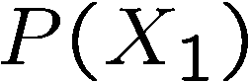
Example: Weather HMM
Rain_{t-1}
Rain_{t}
Rain_{t+1}
Umbrella_{t-1}
Umbrella_{t}
Umbrella_{t+1}
An HMM is defined by:
Initial distribution:
Transitions:
Emissions:
R_{t} | R_{t+1} | P(R_{t+1}|R_{t})
+r | +r | 0.7
+r | -r | 0.3
-r | +r | 0.3
-r | -r | 0.7
R_{t} | U_{t} | P(U_{t}|R_{t})
+r | +u | 0.9
+r | -u | 0.1
-r | +u | 0.2
-r | -u | 0.8
Notes:
demo

Slide 9


Example: Ghostbusters HMM
P(X₁) = uniform
P(X|X’) = usually move clockwise, but sometimes move in a random direction or stay in place
P(R_{ij}|X) = same sensor model as before: red means close, green means far away.
1/9
1/9
1/9
1/9
1/9
1/9
1/9
1/9
1/9
P(X₁)
1/6
1/6
1/2
0
1/6
0
X₁
X₂
X₃
X₄
0
0
0
X₅
P(X|X’=<1,2>)
R_{i,j}
R_{i,j}
R_{i,j}
R_{i,j}
[Demo: Ghostbusters – Circular Dynamics – HMM (L14D2)]
Notes:
Dan has some demo for this.

Slide 10
Video of Demo Ghostbusters – Circular Dynamics -- HMM

Slide 11
Joint Distribution of an HMM
X₁
X₂
X₃
X₅
E₁
E₂
E₃
E₅
Joint distribution:
More generally:
Questions to be resolved:
Does this indeed define a joint distribution?
Can every joint distribution be factored this way, or are we making some assumptions about the joint distribution by using this factorization?

Slide 12
Chain Rule and HMMs
X₁
X₂
X₃
E₁
E₂
E₃
From the chain rule, every joint distribution over can be written as:
Assuming that
gives us the expression posited on the previous slide:

Slide 13
Chain Rule and HMMs
X₁
X₂
X₃
E₁
E₂
E₃
From the chain rule, every joint distribution over can be written as:
Assuming that for all t:
State independent of all past states and all past evidence given the previous state, i.e.:
Evidence is independent of all past states and all past evidence given the current state, i.e.:
gives us the expression posited on the earlier slide:

Slide 14
Implied Conditional Independencies
X₁
X₂
X₃
E₁
E₂
E₃
Many implied conditional independencies, e.g.,
To prove them
Approach 1: follow similar (algebraic) approach to what we did in the Markov models lecture
Approach 2: directly from the graph structure (3 lectures from now)
Intuition: If path between U and V goes through W, then
[Some fineprint later]

Slide 15
HMMs Recap
Explicit assumption for all t :
Consequence, joint distribution can be written as:
Implied conditional independencies:
Past variables independent of future variables given the present
i.e., if or then:
Additional explicit assumption: is the same for all t

Slide 16
Conditional Independence
HMMs have two important independence properties:
Markov hidden process: future depends on past via the present
Current observation independent of all else given current state
Quiz: does this mean that evidence variables are guaranteed to be independent?
[No, they tend to correlated by the hidden state]
X₁
X₂
X₃
X₄
X₅
E₁
E₂
E₃
E₄
E₅

Slide 17
Real HMM Examples
Speech recognition HMMs:
Observations are acoustic signals (continuous valued)
States are specific positions in specific words (so, tens of thousands)
Machine translation HMMs:
Observations are words (tens of thousands)
States are translation options
Robot tracking:
Observations are range readings (continuous)
States are positions on a map (continuous)

Slide 18
Filtering / Monitoring
Filtering, or monitoring, is the task of tracking the distribution B_{t}(X) = P_{t}(X_{t} | e₁, …, e_{t}) (the belief state) over time
We start with B₁(X) in an initial setting, usually uniform
As time passes, or we get observations, we update B(X)
The Kalman filter was invented in the 60’s and first implemented as a method of trajectory estimation for the Apollo program
Notes:
Dan has some demo for this

Slide 19
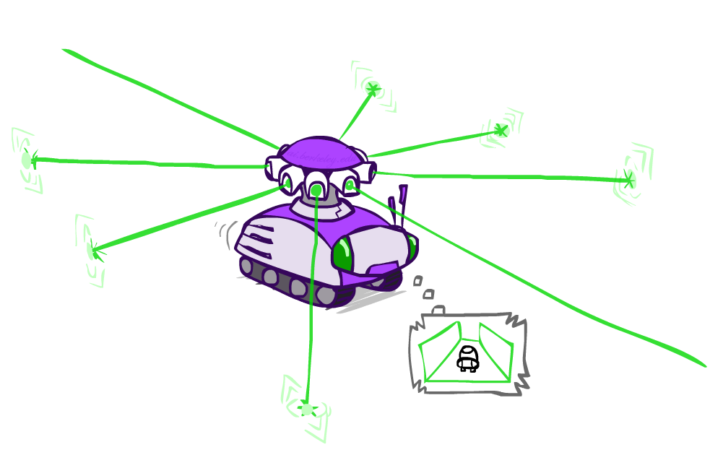
Example: Robot Localization
Example from Michael Pfeiffer
Prob
0
1
t=0
Sensor model: can read in which directions there is a wall, never more than 1 mistake
Motion model: may not execute action with small prob.

Slide 20
Example: Robot Localization
Prob
0
1
t=1
Lighter grey: was possible to get the reading, but less likely b/c required 1 mistake

Slide 21
Example: Robot Localization
Prob
0
1
t=2

Slide 22
Example: Robot Localization
Prob
0
1
t=3

Slide 23
Example: Robot Localization
Prob
0
1
t=4

Slide 24
Example: Robot Localization
Prob
0
1
t=5

Slide 25
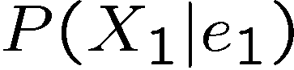
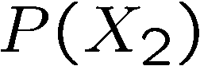
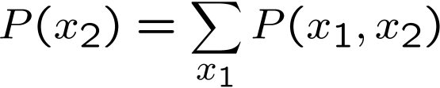
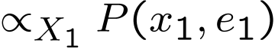
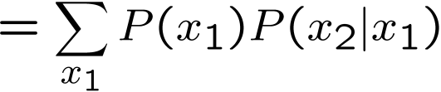
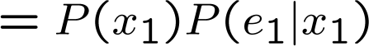
Inference: Base Cases
X₁
X₁
X₂
E₁

Slide 26
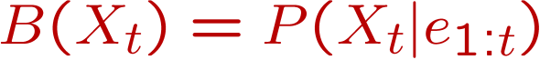
Passage of Time
Assume we have current belief P(X | evidence to date)
Then, after one time step passes:
Basic idea: beliefs get “pushed” through the transitions
With the “B” notation, we have to be careful about what time step t the belief is about, and what evidence it includes
X₁
X₂
Or compactly:
Notes:
TODO: intermediate step in derivation!

Slide 27

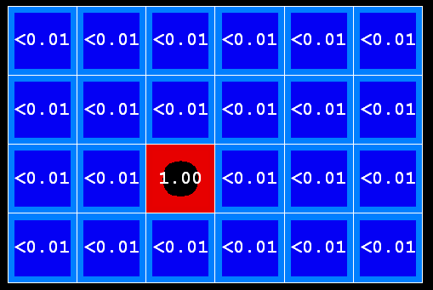
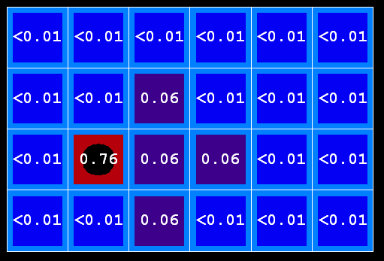
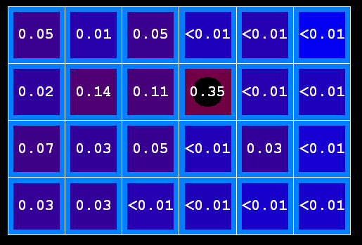
Example: Passage of Time
As time passes, uncertainty “accumulates”
(Transition model: ghosts usually go clockwise)
T = 1
T = 2
T = 5

Slide 28
Observation
X₁
Assume we have current belief P(X | previous evidence):
Then, after evidence comes in:
Or, compactly:
E₁
Basic idea: beliefs “reweighted” by likelihood of evidence
Unlike passage of time, we have to renormalize
Notes:
Basic idea: beliefs “reweighted” by likelihood of evidence
Unlike passage of time, we have to renormalize

Slide 29


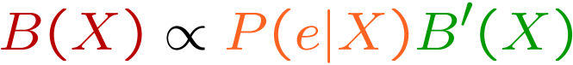
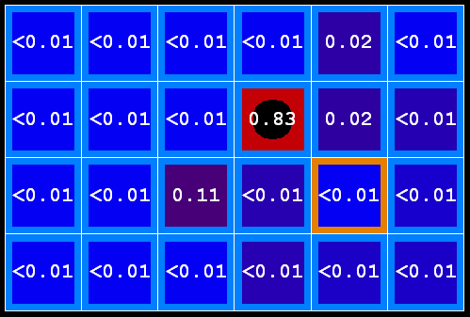
Example: Observation
As we get observations, beliefs get reweighted, uncertainty “decreases”
Before observation
After observation

Slide 30
Example: Weather HMM
B’(+r) = 0.5
B’(-r) = 0.5
B’(+r) = 0.627
B’(-r) = 0.373
B(+r) = 0.5
B(-r) = 0.5
B(+r) = 0.818
B(-r) = 0.182
B(+r) = 0.883
B(-r) = 0.117
Rain₀
Rain₁
Rain₂
R_{t} | R_{t+1} | P(R_{t+1}|R_{t})
+r | +r | 0.7
+r | -r | 0.3
-r | +r | 0.3
-r | -r | 0.7
R_{t} | U_{t} | P(U_{t}|R_{t})
+r | +u | 0.9
+r | -u | 0.1
-r | +u | 0.2
-r | -u | 0.8
Umbrella₁
Umbrella₂
Notes:
demo

Slide 31
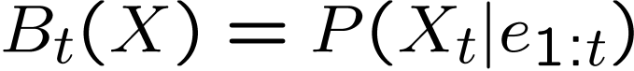
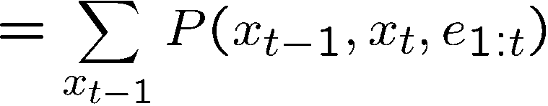
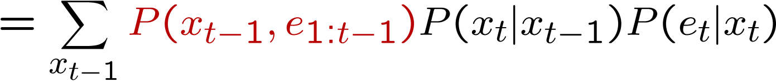
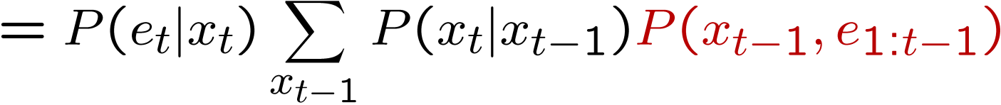
The Forward Algorithm
We are given evidence at each time and want to know
We can derive the following updates
We can normalize as we go if we want to have P(x|e) at each time step, or just once at the end…
Notes:
TODO: explain propto and it’s X_t, not X

Slide 32
Online Belief Updates
Every time step, we start with current P(X | evidence)
We update for time:
We update for evidence:
The forward algorithm does both at once (and doesn’t normalize)
X₁
X₂
X₂
E₂

Slide 33
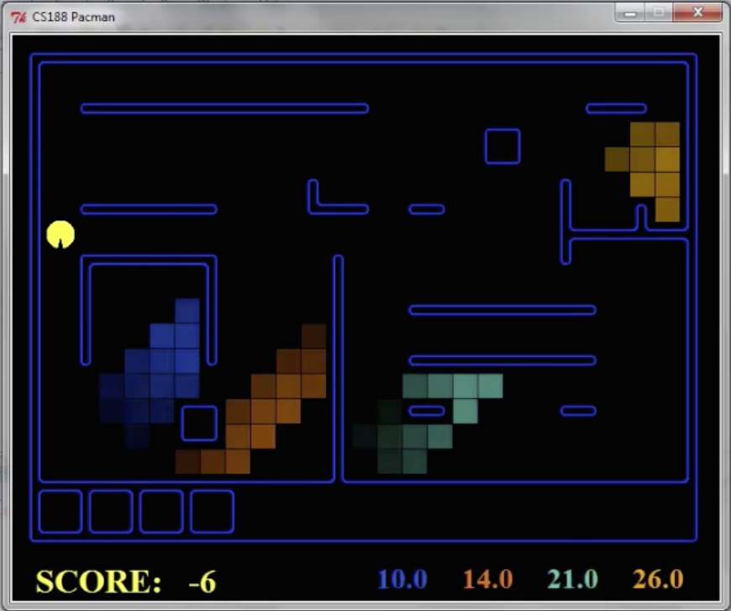
Pacman – Sonar (P4)
[Demo: Pacman – Sonar – No Beliefs(L14D1)]

Slide 34
Video of Demo Pacman – Sonar (with beliefs)

Slide 35
Next Time: Particle Filtering and Applications of HMMs

